Slide 1


Wine Quality Prediction using Machine Learning
Data-driven approach to evaluate wine quality
Presented by:
Ankam Sai Anirudh [RA2311026010087]
Atharva Bhutada [RA2311026010089]
Vansh Agrawal [RA2311026010120]
Shashwat Sharma [RA2311026010121]

Slide 2

PROJECT OVERVIEW
Abstract: Enhancing Wine Assessment
Our project automates wine quality assessment using machine learning. We predict quality based on chemical properties.
This approach offers a data-driven, objective method, reducing reliance on subjective human tasting panels.
Objective
Predict wine quality based on chemical properties, leveraging ML for efficiency and precision in the food & beverage industry.

Slide 3
WHY IT MATTERS
Introduction: The Need for Precision
What is Wine Quality Prediction?
Why it's Crucial
Using data science to assign a quality score to wine based on its measurable chemical composition.
Ensures consistent product quality, optimizes production, and meets consumer expectations in the competitive beverage market.
Challenges of Manual Testing
ML to the Rescue
Time-consuming, subjective, prone to human error, and inconsistent across different tasters.
Machine learning provides an objective, rapid, and scalable method to improve accuracy and consistency in quality assessment.

Slide 4
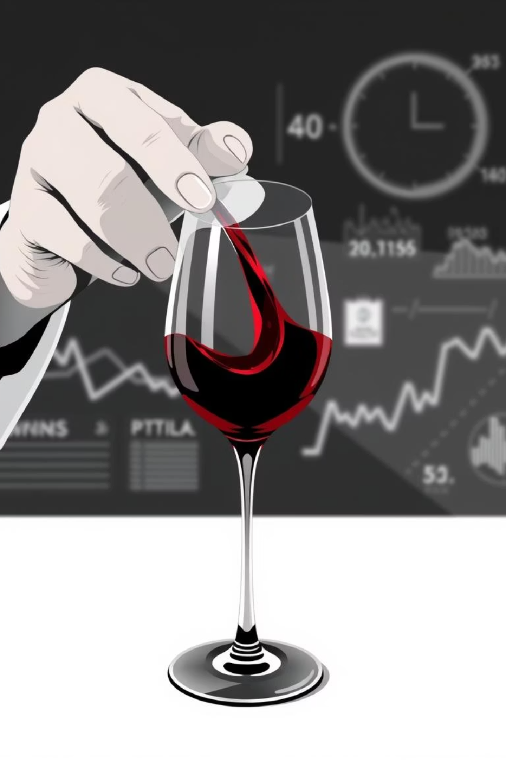

THE CORE CHALLENGE
Problem Statement: Beyond Subjectivity
The industry needs automated, data-driven solutions for reliable quality control. This is where machine learning shines.
Traditional Assessment Limitations
Time-consuming
Our goal: Develop an ML model to classify/predict wine quality using measurable chemical features, ensuring precision and efficiency.
Highly subjective
Inconsistent results
Labor-intensive

Slide 5
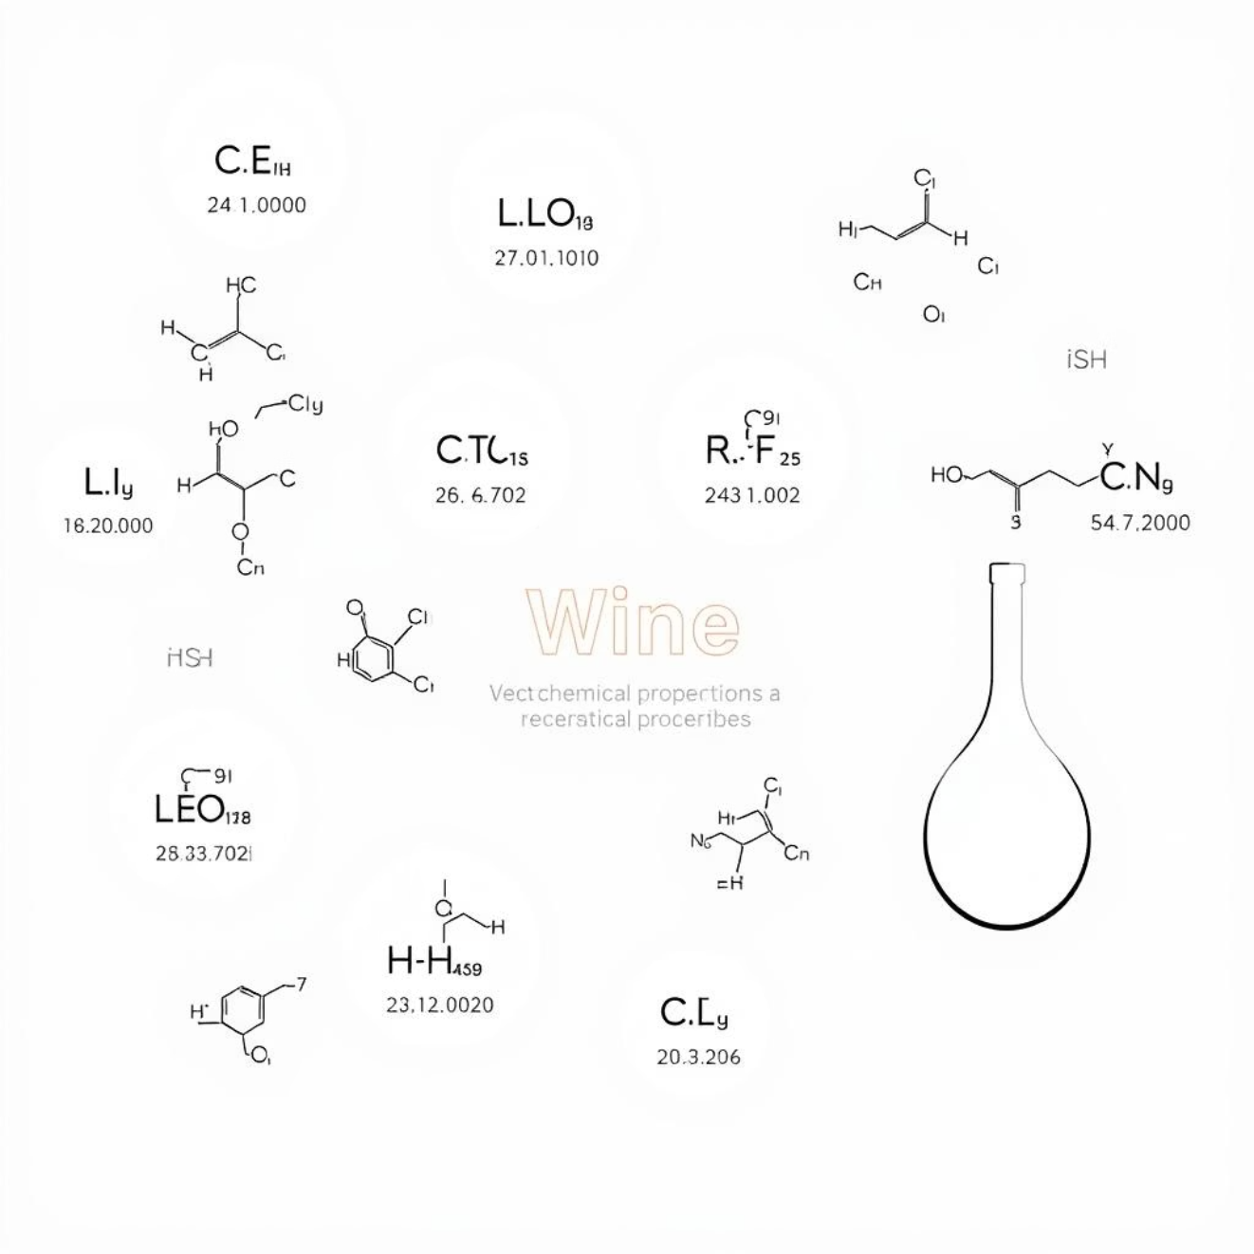
THE FOUNDATION
Dataset: The Chemical Fingerprint
Our model is built on a rich CSV dataset detailing the chemical properties of wine samples.
Each entry includes a comprehensive set of features:
Fixed Acidity
Volatile Acidity
Citric Acid
Residual Sugars
Chlorides
Free Sulfur Dioxide
Total Sulfur Dioxide
Density
pH
Sulphates
Alcohol
Quality is our target variable, the ultimate output of our prediction model.

Slide 6
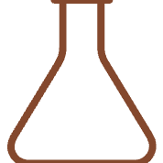



OUR TOOLKIT
Technologies & Models
Python
Jupyter Notebook
The core programming language for development.
Interactive environment for rapid prototyping and analysis.
Key Libraries
ML Models
Pandas, NumPy, Matplotlib, Seaborn, Scikit-learn for data handling, visualization, and ML.
Logistic Regression, Random Forest, Decision Tree, Support Vector Machines.
These tools enable robust data processing, model training, and performance evaluation.

Slide 7
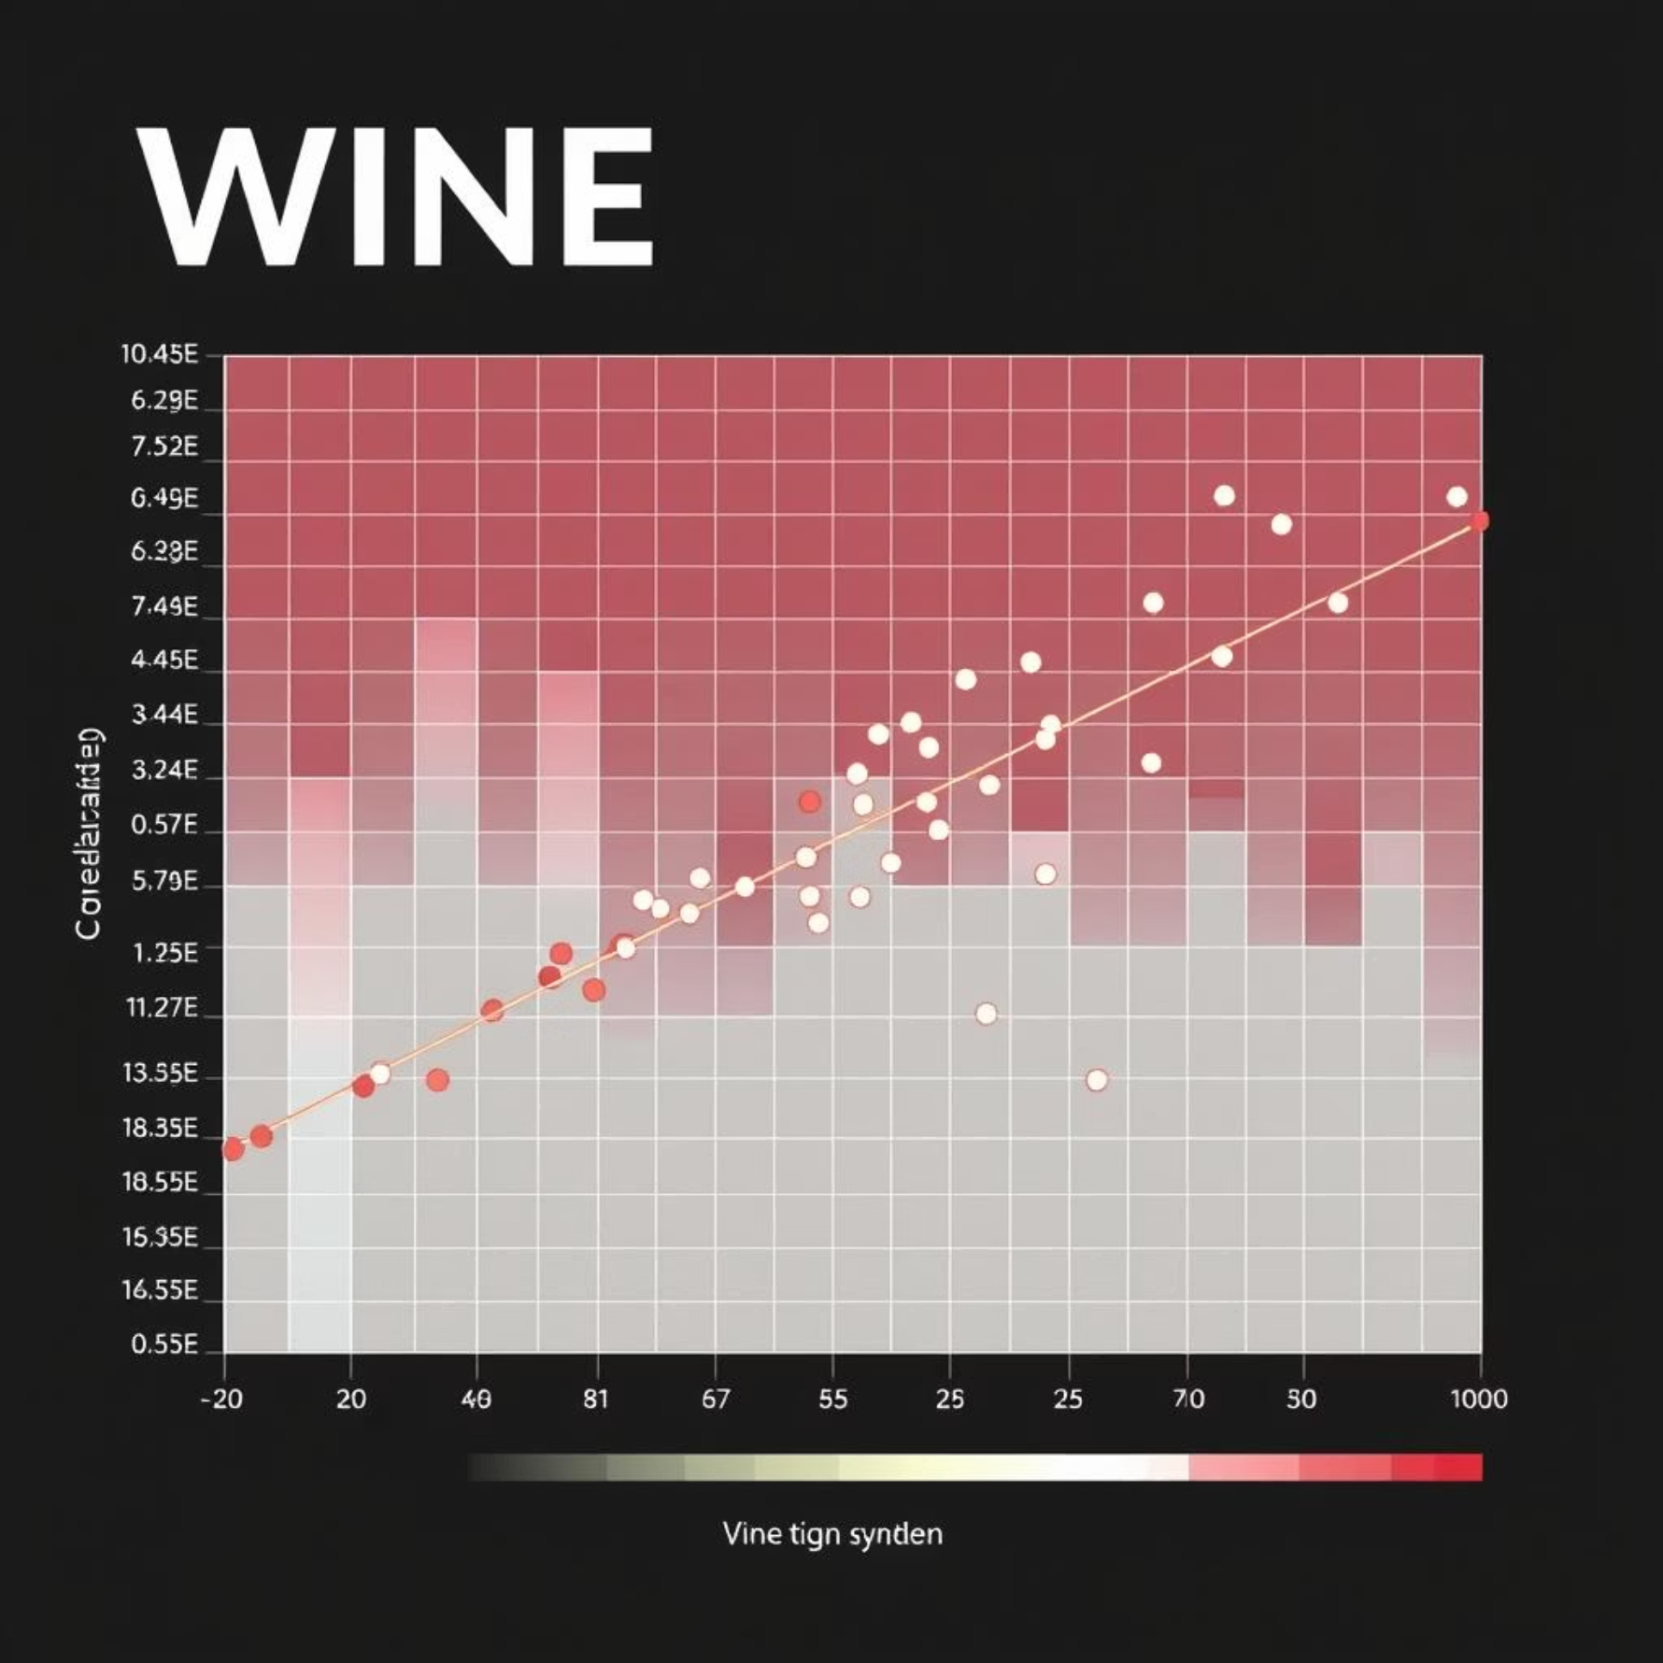
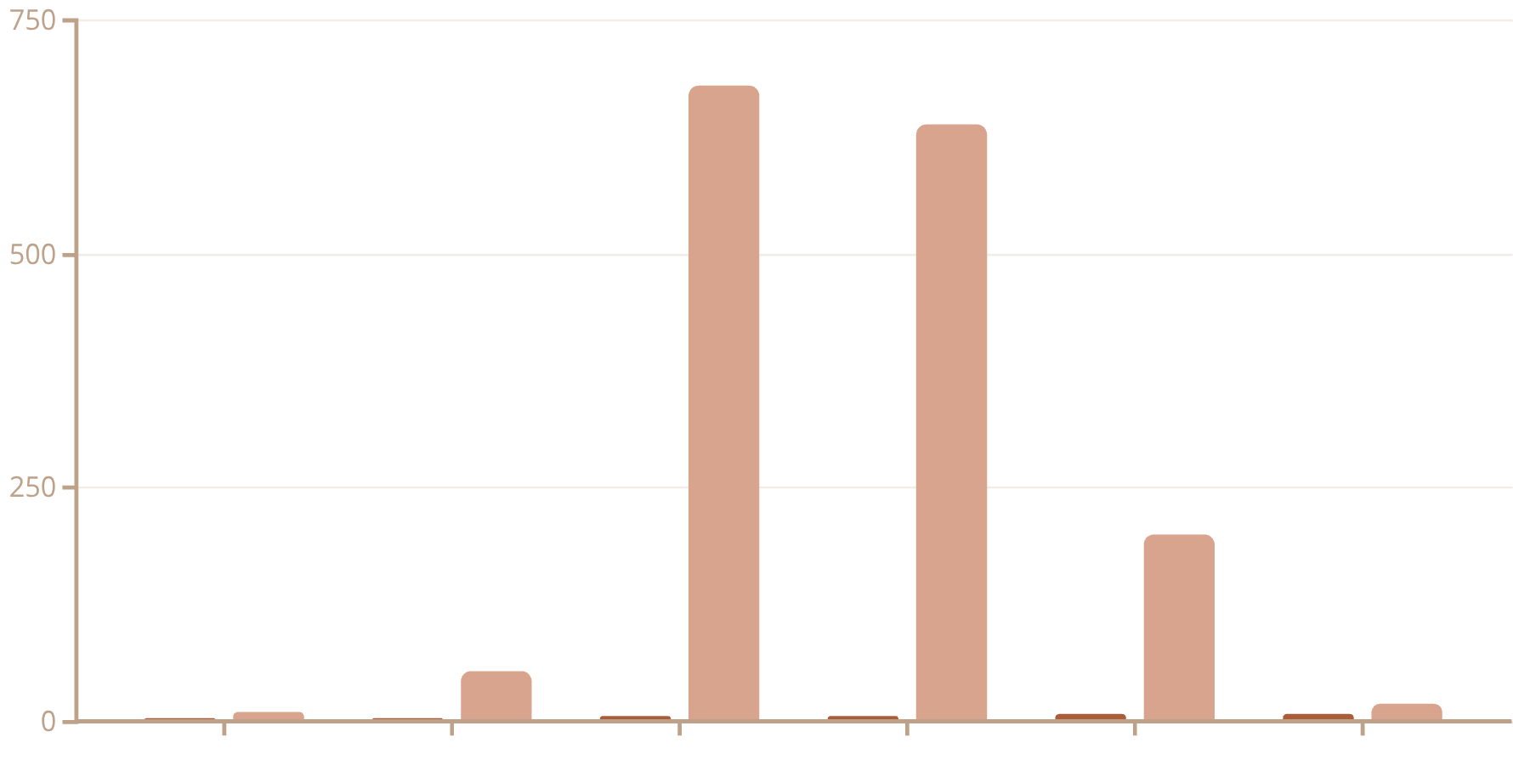
VISUALIZING INSIGHTS
Data Analysis & Visualization
Quality Score
Number of Wines
Distribution of Wine Quality: Most wines fall within the average quality range (5-6).
Alcohol vs. Quality: Higher alcohol content tends to correlate with higher quality scores.
Feature Correlation: Heatmap reveals strong relationships between specific chemical properties.

Slide 8
EVIDENCE & METRICS
Comparison & Performance
Time
Hours/Days
Seconds/Minutes
Subjectivity
High
Low
Consistency
Variable
High
Cost
High (labor, travel)
Lower (initial setup)
ML models offer significant advantages over traditional methods in speed, consistency, and cost-effectiveness.
Logistic Regression
0.72
0.70
0.71
Decision Tree
0.76
0.75
0.75
Random Forest
0.81
0.80
0.80
Random Forest consistently delivered the highest performance metrics among the models tested.

Slide 9
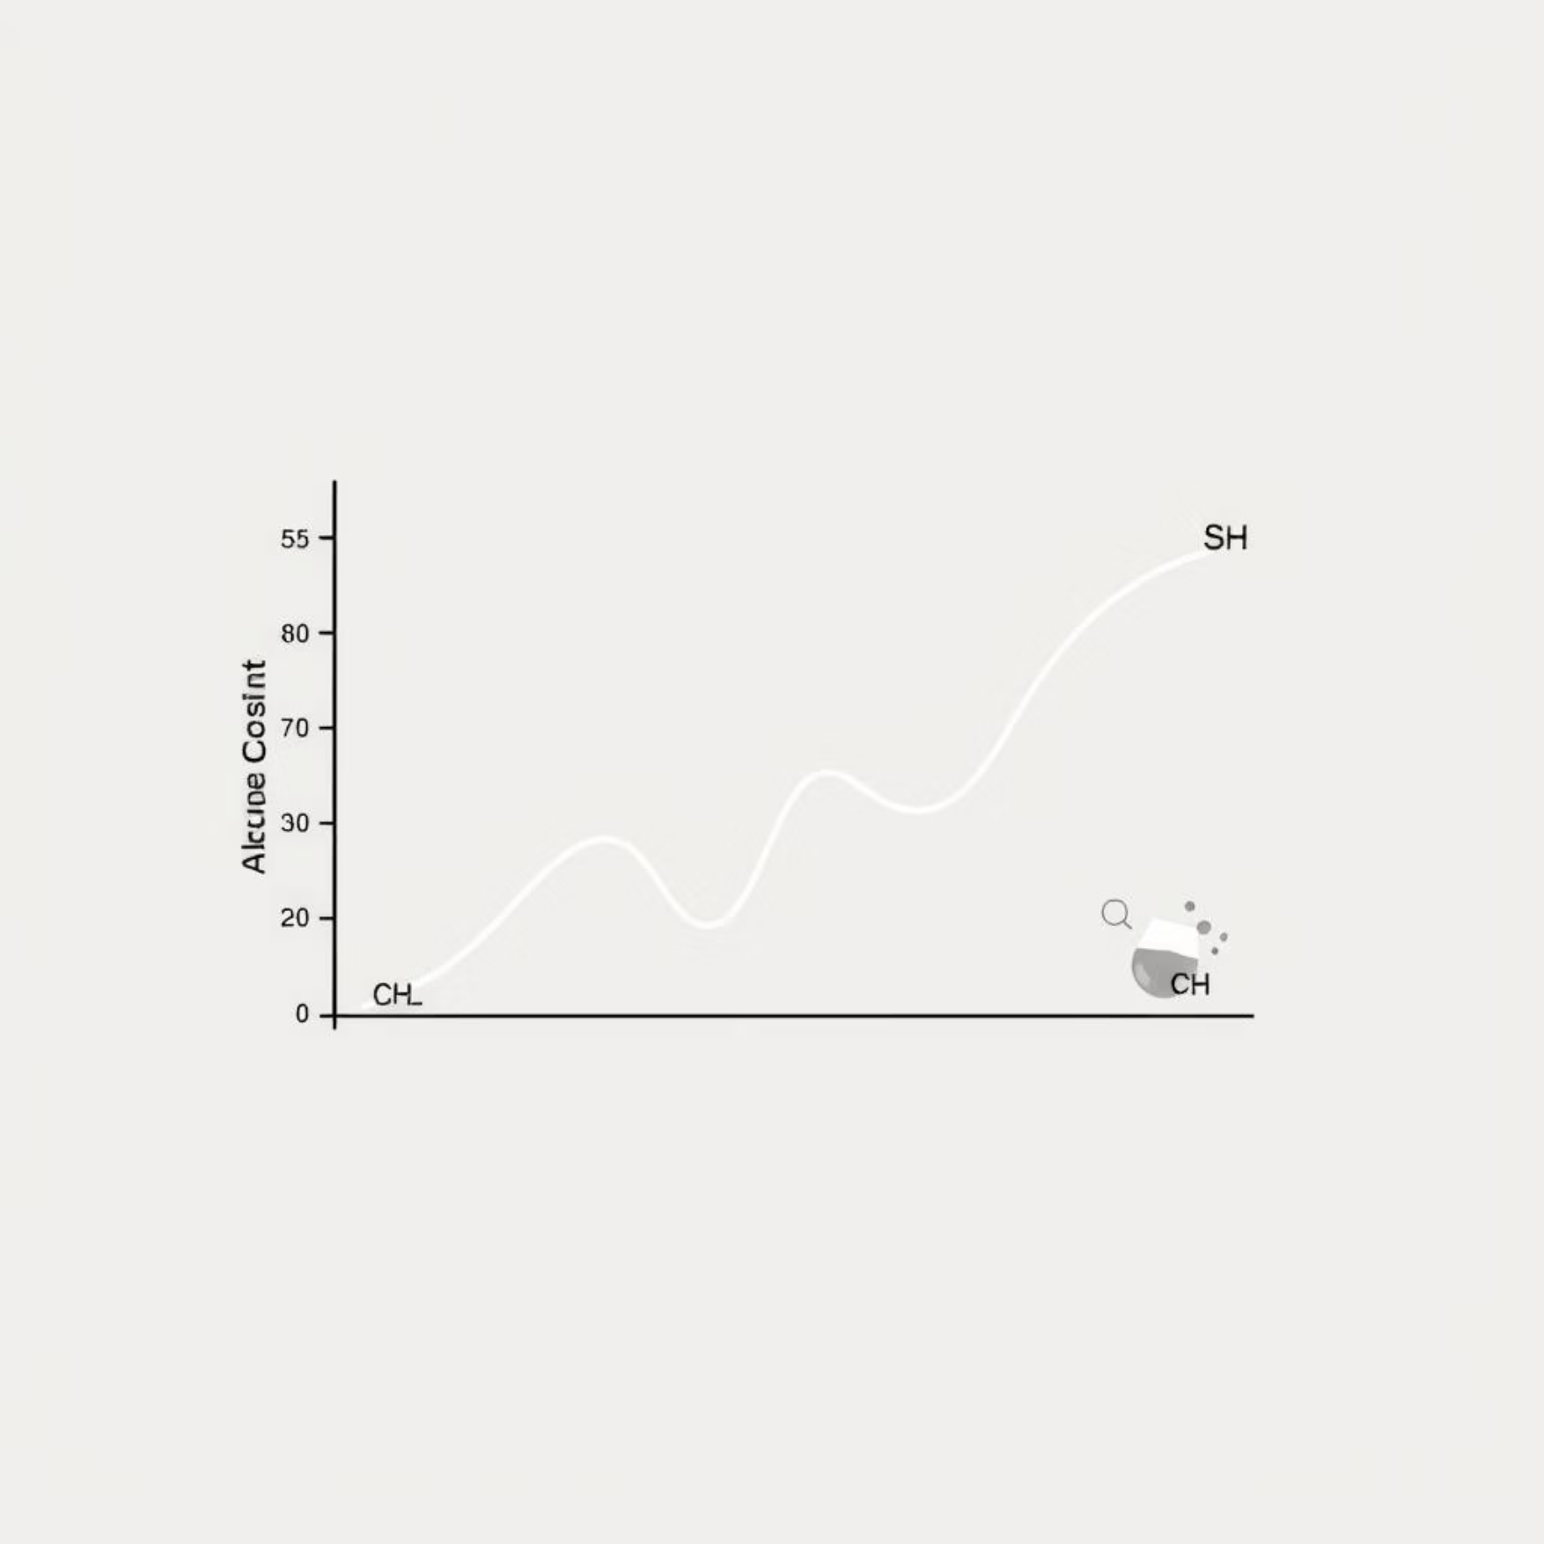
DISCOVERIES & IMPLICATIONS
Results & Discussion
Key findings from the dataset include:
Model Performance:
Alcohol content and sulphates are consistently among the most influential features for predicting wine quality.
81%
Volatile acidity shows a strong inverse correlation: lower values often indicate higher quality.
Random Forest Accuracy
Highest overall predictive accuracy.
76%
Decision Tree
Strong performance, good interpretability.
72%
Logistic Regression
Baseline performance for comparison.
Our chosen ML models effectively classify wine quality, with Random Forest demonstrating superior predictive power.

Slide 10
LOOKING AHEAD
Future Scope & Conclusion
1
2
Deep Learning
Application Development
Explore neural networks for even higher accuracy.
Deploy as a web/mobile app for wineries.
3
4
IoT Integration
Expand Scope
Real-time quality checks with smart sensors.
Apply to other beverages beyond wine.
Conclusion:
Machine learning offers an efficient, accurate, and scalable solution for predicting wine quality, significantly reducing subjectivity and human error. This innovative approach has the potential to transform quality control across the entire beverage industry.

